Slide 1

USB-C — THE FUTURE OF MEETING ROOM CONNECTIVITY
PRESENTED BY RETHINK AV
THE FUTURE OF
CONNECTIVITY
IS USB-C.
One cable. Audio, video, USB, power and data.

Slide 2
“
The future of connectivity is USB-C.

Slide 3
THE PROBLEM
THE MEETING ROOM IS BROKEN
Every meeting starts the same way.
01
02
03
CABLE CHAOS
USB-C FRAGMENTATION
VENDOR LOCK-IN
Three dongles per laptop. A drawer full of adapters. Five minutes lost before a word is said.
EU mandates USB-C, but the room is HDMI. Half the team is USB-C, half HDMI. Nothing talks.
Your UC platform changed; your hardware didn’t. Now you need a new switcher, matrix and contract.
There’s a better way.

Slide 4
THE TECHNOLOGY
THE EVOLUTION OF USB-C DATA
Four generations of one connector — each one faster than the last.
USB 1.0
USB 2.0
USB 3.0
USB 3.2 Gen 1
1996
2000
2008
2013
12 Mbps
480 Mbps
5 Gbps
10 Gbps
MAX TRANSFER RATE
MAX TRANSFER RATE
MAX TRANSFER RATE
MAX TRANSFER RATE

Slide 5
REGULATION / UNITED STATES
US LAW
NO FEDERAL MANDATE
There is currently no federal US law requiring USB-C across devices.
CALIFORNIA LEADS
A 2023 California law would require new phones and laptops to adopt USB-C by 2026.
SENATE PRESSURE
US senators are pushing for an EU-style federal universal-charging policy to cut e-waste.
BEHIND THE EU
The US trails the European Union, which already mandates USB-C for many portable electronics.

Slide 6
REGULATION / EU & UK
EU & UK LAW
USB-C CHARGER
LAPTOPS
UNIVERSAL STANDARD
2026 DEADLINE
The EU Common Charger Directive makes USB-C the universal charging standard for phones, tablets, cameras and headphones — effective 28 December 2024.
Laptops have until 28 April 2026 to comply. The aim: reduce electronic waste and let a single charger power multiple devices.

Slide 7
WHY IT MATTERS
THE MARKET HAS DECIDED.
Demand and device support have already moved to USB-C.
95%
84%
10Gbps
WANT USB-C AS THE STANDARD
OF DEVICES ALREADY SUPPORT USB-C
FAST NETWORK & CHARGING SPEEDS

Slide 8





WHAT ARE WE TRYING TO ACHIEVE?
THE 5 ELEMENTS
One USB-C cable carries all five — nothing left on the table.
AUDIO
VIDEO
USB
POWER
DATA

Slide 9
THE DIFFERENCE
WHY RETHINK
Three things you won’t get from anyone else.
01
02
03
BRITISH BY DESIGN
50+ YEARS DEEP
BACKED BY ASCENTAE
Pantone 186C runs through everything.
We didn’t start last year.
UK distribution that ships.
Designed in the UK and engineered for British and European standards from the ground up. The red on every product is the red that flies on the Union Flag.
Five decades of AV integration experience behind every product. We’ve seen every meeting-room failure mode — and built the answer.
Distributed in the UK through Ascentae, with stock on shelves, demo units available and the support to back every install.

Slide 10
THE PORTFOLIO
FOUR FAMILIES. ONE SYSTEM.
One coherent system for the modern meeting room.
KRATOS
MAGNI
SWITCHERS
MATRICES
USB-C and HDMI auto-switchers with integrated conferencing. The presenter just plugs in.
Multi-input, multi-output presentation matrices for boardrooms and divisible spaces.
OSIRIS
UC SMARTHUB
EXTENDERS
ACCESSORIES
Signal transmission over Cat6A/7 up to 100m. Video, USB and power over a single cable.
Three-port USB 3.0 auto-switcher for effortless device sharing between two hosts.

Slide 11
THE RETHINK RANGE
THE RANGE
THE
PRODUCTS.
Switchers. Extenders. Matrices. Accessories.

Slide 12
PRODUCT FAMILY
PRODUCT FAMILY 01
KRATOS
Switchers & Switcher Extenders

Slide 13
KRATOS
4K USB-C & HDMI BYOM SWITCHERS
Hassle-free installation. Dependable performance. Built for AV pros who can’t afford a callback.
RAV-SW-C2x1HU
RAV-SW-2x1HU
RAV-SW-4x1HU-VC
COMPACT 2×1
STANDARD 2×1
4×1 + CONFERENCING
Compact 2×1 HDMI & USB-C auto switch. Audio, video, USB, power and data.
2×1 HDMI & USB-C auto switch with full power delivery and BYOM support.
4×1 HDMI & USB-C auto switch with integrated video conferencing.

Slide 14

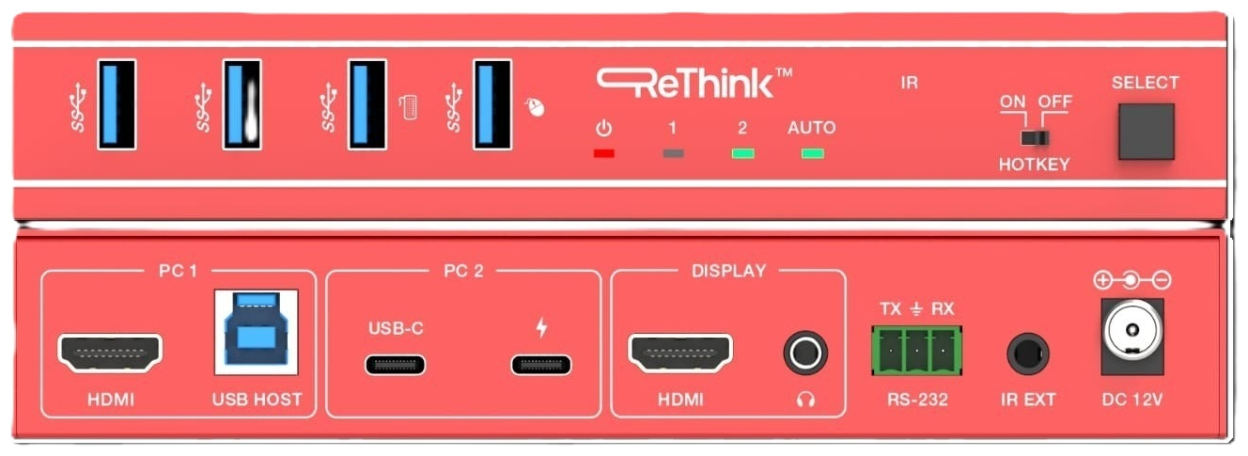
SWITCHERS / KRATOS
RAV-SW-C2x1HU
THE FLAGSHIP CONFERENCING SWITCHER
4×1 HDMI & USB-C auto switch with integrated video conferencing.
AUTO-SWITCHING
Latest source wins — no remote, no menu.
CONFERENCING
Camera, mic and speaker pass-through for BYOM.
ONE-CABLE BYOM
Audio, video, USB, power and data over USB-C.
HDMI ×3
USB-C
AUDIO
VIDEO
4K @ 60Hz
POWER
Uncompressed video to the room display.

Slide 15






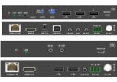
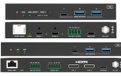
KRATOS
4K USB-C & HDMI BYOM (Bring Your Own Meeting) Switchers
RAV-SW-SmartHub
RAV-SW-C2x1HU
RAV-SW-2x1U
RAV-SW-2x1HU
RAV-SW-4x1HU
RAV-SW-4x1HU-VC
RAV-SW-2x1HU100-T/RX
RAV-SW-2x1U2CH100-Tx/Rx
VIDEO
Video Inputs
—
1× USB-C 4K@60
1× HDMI 4K@60
2× USB-C 4K@60
1× USB-C 4K@60
1× HDMI 4K@60
2× USB-C 4K@60
2× HDMI 4K@60
3× HDMI 4K@60
1× USB-C 4K@30
1× HDMI 4K@60
1× USB-C 4K@60
2× USB-C 4K@60
Video Outputs
—
1× HDMI 4K@60
1× HDMI 4K@60
1× HDMI 4K@60
1× HDMI 4K@60
1× HDMI 4K@60
1× HDMI 4K@60
2× HDMI 4K@60
Extended Desktop
—
—
—
—
—
—
—
✓
USB
USB (Device)
3× USB-A (3.0)
4× USB-A (3.2 Gen1)
HotKey: 2× USB 1.1
1× USB-C (3.2 Gen1)
2× USB-A (3.2 Gen1)
1× USB-C (3.2 Gen1)
2× USB-A (3.2 Gen1)
1× USB-C (3.2 Gen1)
2× USB-A (3.2 Gen1)
1× USB-A (1.1), 1× USB-A (2.0)
2× USB-A (3.0)
3× USB-A (2.0)
1× USB-C (3.2 Gen1)
2× USB-A (3.2 Gen1)
USB (Host)
2× USB-B
1× Combined on USB-C
1× USB-B
2× Combined on USB-C
1× Combined on USB-C
1× USB-B
2× Combined on USB-C
1× USB-C & 1× USB-B
1× Combined on USB-C
3× USB-B
1× Combined on USB-C
1× USB-B
2× Combined on USB-C
AUDIO
Analogue In/Out
—
—
Embedder &
De-embedder
Embedder &
De-embedder
Embedder &
De-embedder
—
Embedder &
De-embedder
De-embedder
CONTROL
Host Switching
Automatic / Manual
Automatic / Manual
IR Remote / HotKey
Automatic / Manual
IR Remote
Automatic / Manual
IR Remote
Automatic / Manual
IR Remote
Automatic / Manual
IR Remote / HotKey
Automatic / Manual
Automatic / Manual
API Control
RS-232
—
TCP/IP & RS-232
TCP/IP & RS-232
TCP/IP & RS-232
TCP/IP & RS-232
RS-232 &
RS-232 Pass-through
RS-232 Pass-through
Network Port
—
—
2
2
2
1
—
—
Web GUI
—
—
✓
✓
✓
✓
—
—
EDID Management
—
Pass-through
Configurable
Configurable
Configurable
Configurable
Pass-through
Pass-through
EXTENSION
Distance
—
—
—
—
—
—
100m 4K@60
150m 1080@60
100m 4K@60
POWER DELIVERY
USB-C Charging
—
100W via USB-C PD
100W (2 ports)
100W
100W
60W & 100W (opt. PSU)
60W
✓
PoC
5V USB or PSU
—
—
—
—
—
✓
✓

Slide 16
PRODUCT FAMILY
PRODUCT FAMILY 02
OSIRIS
Extenders — signal that doesn’t quit

Slide 17
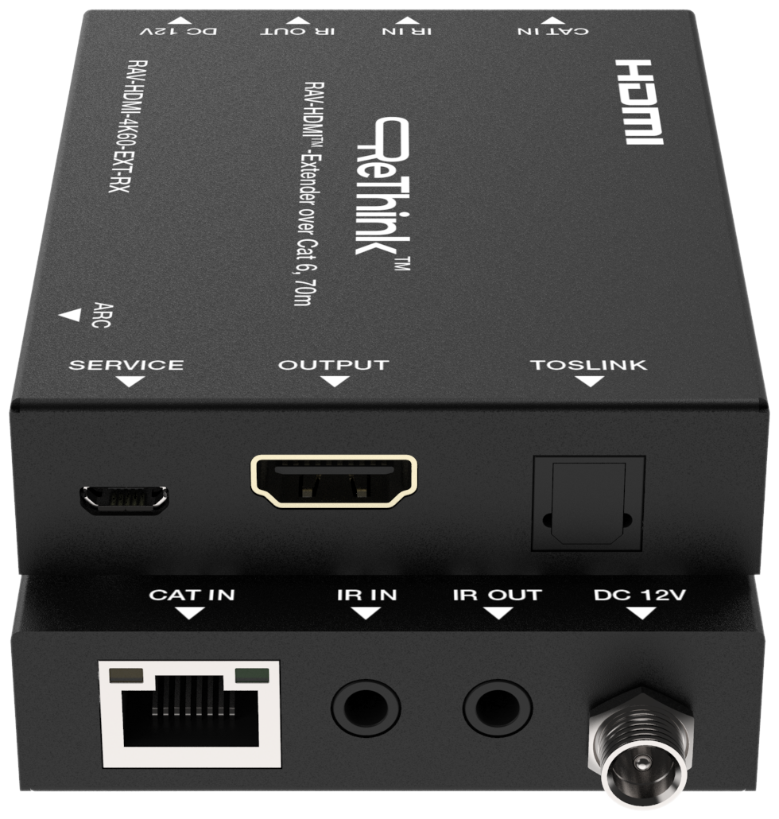
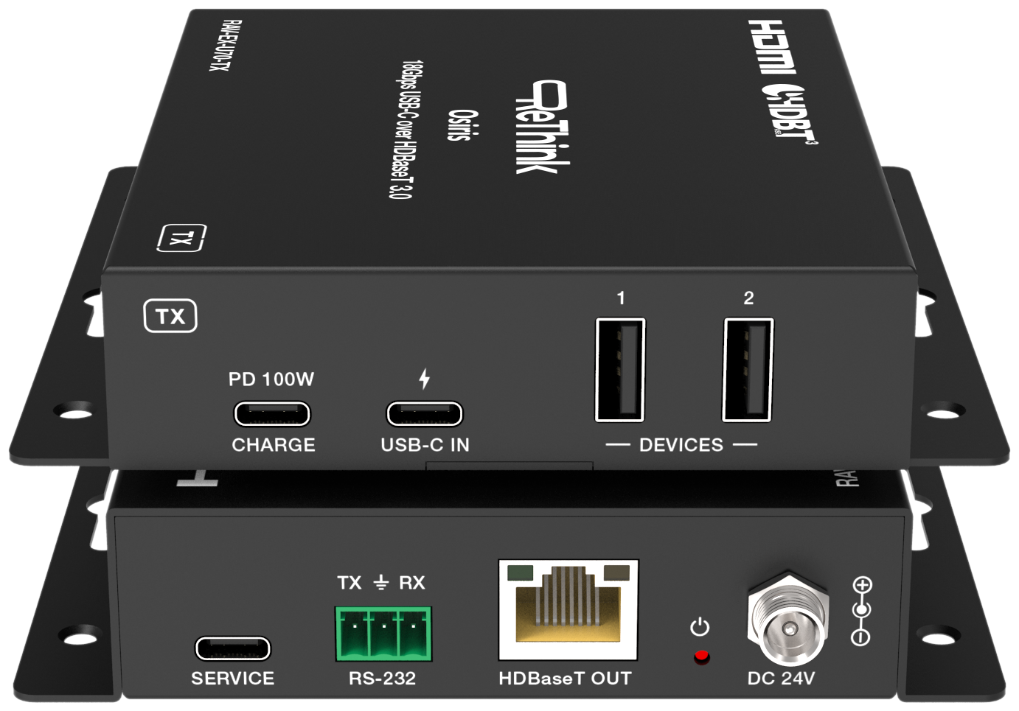
OSIRIS
HDBASET EXTENDERS OVER CAT 6
Transmitter & receiver pairs that push signal the length of the building.
RAV-EX-H70-Tx/Rx
RAV-EX-U70-Tx/Rx
HDMI EXTENDER
USB-C EXTENDER
HDMI over HDBaseT — 4K UHD up to 60m on a single Cat 6 cable.
USB-C video + USB extension over HDBaseT for mid-distance installs.

Slide 18
PRODUCT FAMILY
PRODUCT FAMILY 03
MAGNI
Matrices — multi-input, multi-output

Slide 19






MAGNI
4K USB-C & HDMI BYOM (Bring Your Own Meeting) Matrix Switchers
RAV-MS-4x2HU
RAV-MS-4x2HU-MST
RAV-MS-4x2HU-Tx
RAV-MS-4x2HUD-Tx
RAV-MV-4x2HU-Tx/Rx
RAV-MS-4x2DLHU-Tx/Rx
VIDEO
Video Inputs
2× USB-C 4K60
2× HDMI 4K60
1× USB-C (MST) 4K60
2× HDMI 4K60
2× USB-C 4K60
2× HDMI 4K60
2× USB-C 4K60
2× HDMI 4K60
Tx: 2× USB-C 4K60 & 2× HDMI 4K60
Rx: 1× HDMI 4K60
Tx: 2× USB-C 4K60 & 2× HDMI 4K60
Rx: 2× HDMI 4K60
Video Outputs
2× HDMI 4K60
2× HDMI 4K60
2× HDMI 4K60
2× HDMI 4K60
2× HDMI 4K60
2× HDMI 4K60
Extended Desktop
—
✓
✓
✓
—
✓
USB
USB (Device)
1× USB-C & 2× USB-A (3.2 Gen1)
1× USB-C & 2× USB-A (3.2 Gen1)
4× USB-A (3.2 Gen1)
4× USB-A (3.2 Gen1)
Tx: 1× USB-C & 3× USB-A (3.2 Gen1)
& 2× USB-A (1.1)
Rx: 2× USB-A (2.0)
Tx: 1× USB-C & 2× USB-1 (3.2 Gen1)
Rx: 1× USB-C & 2× USB-1 (3.2 Gen1)
USB (Host)
2× Combined on USB-C, 1× USB-C
1× USB-B (3.2 Gen1)
1× Combined on USB-C, 1× USB-C
1× USB-B (3.2 Gen1)
2× Combined on USB-C
2× USB-B
2× Combined on USB-C
2× USB-B
Tx: 2× Combined on USB-C
& 2× USB-B (3.2 Gen1)
Rx: 1× USB-B (2.0)
Tx: 2× Combined on USB-C, 1× USB-C
& 1× USB-B (3.2 Gen1)
Rx: 1× USB-B (3.2 Gen1)
AUDIO
Analogue In/Out
Embedder & De-embedder
Embedder & De-embedder
Embedder & De-embedder
Embedder & De-embedder
Embedder & De-embedder
Embedder & De-embedder
Dante
—
—
—
✓
✓
—
CONTROL
Host Switching
Automatic / Manual
Automatic / Manual
Automatic / Manual
Automatic / Manual
Automatic / Manual
Automatic / Manual
API Control
TCP/IP & RS-232
TCP/IP & RS-232
TCP/IP & RS-232
TCP/IP & RS-232
TCP/IP & RS-232
TCP/IP & RS-232
Network Port
2
2
2
2
Tx: 1
Tx: 2 & Rx: 1
Web GUI
✓
✓
✓
✓
✓
✓
EDID Management
Configurable
Configurable
Configurable
Configurable
Configurable
Configurable
EXTENSION
Distance
—
—
100m 4K60
with optional Rx (RAV-EX-HDBT-TRx)
100m 4K60
with optional Rx (RAV-EX-HDBT-TRx)
40m 4K60
70m 1080P60
100m 4K60
POWER DELIVERY
USB-C Charging
2× 60W
1× 100W
2× 60W
2× 60W
2× 60W
2× 60W
PoC
—
—
—
—
Rx powered from Tx
✓

Slide 20
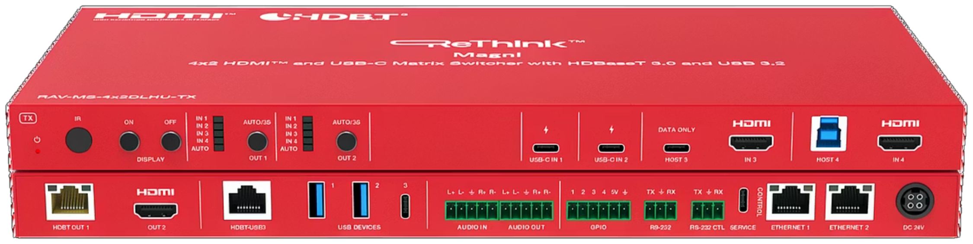
MATRICES / MAGNI
RAV-MS-4x2DLHU-Tx/Rx
THE WORLD’S FIRST HDBASET 3.0 + USB 3.2 MATRIX SWITCHER
Four inputs, two independent HDMI outputs at 100m over a single Cat 6 cable.
4×2 MATRIX
4 Tx + 3 Rx inputs → 2 independent HDMI outputs
100m REACH
Full HDBaseT 3.0 + USB 3.2 over a single Cat 6A cable
4K @ 60Hz
Uncompressed 4:4:4 video — no scaling, no shortcuts
100W CHARGING
USB-C PD, 1G Ethernet, DP-Alt — one cable does it all

Slide 21
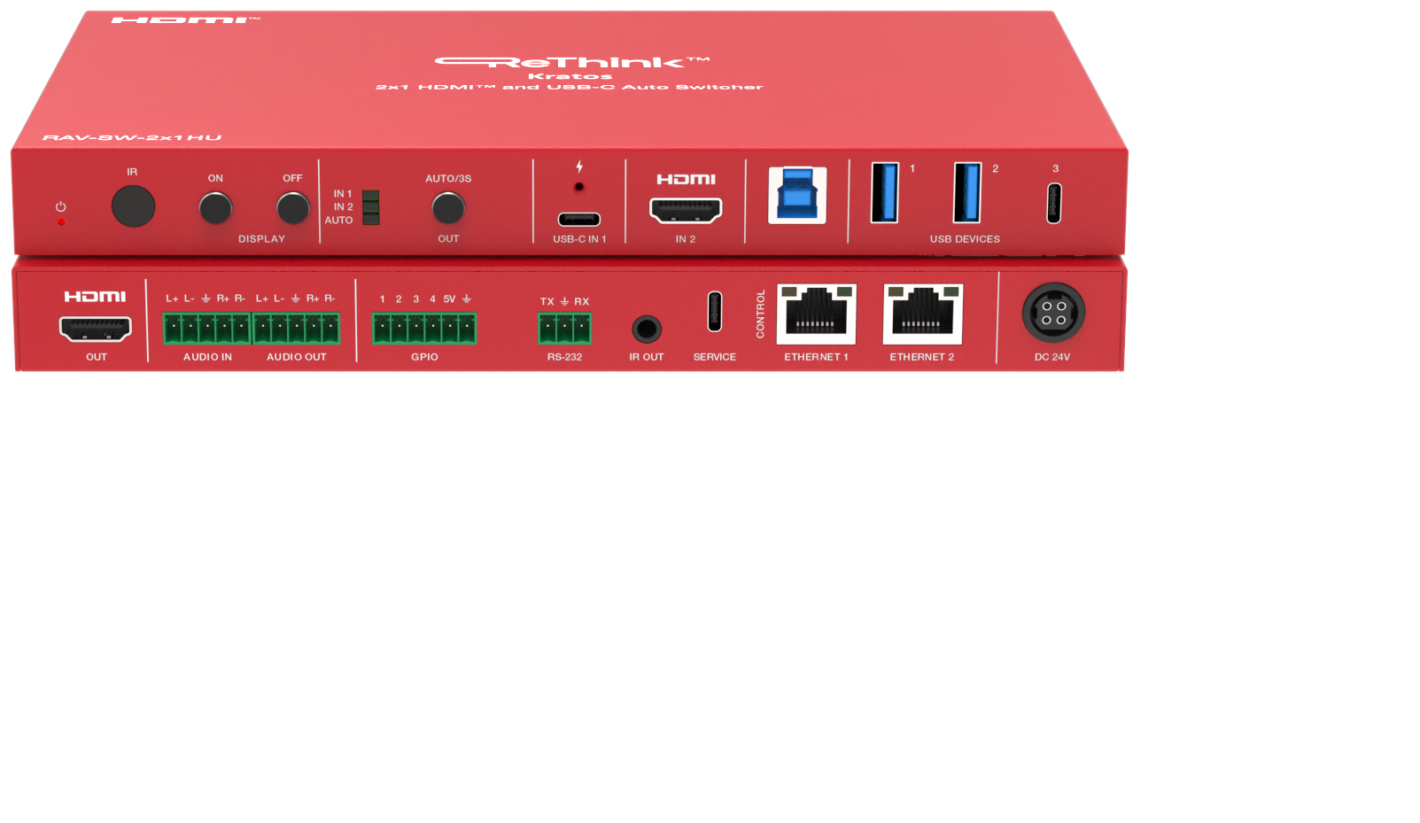
MATRICES / MAGNI
RAV-SW-4x2HU
4×2 HDMI & USB-C PRESENTATION SWITCH
Multi-source presentation switching for boardrooms and divisible spaces.
4×2 SWITCHING
Four sources to two independent displays.
USB-C BYOM
Bring your own meeting from any device.
DUAL OUTPUT
Drive two rooms or two screens at once.
HDMI ×2
USB-C ×2
AUDIO
VIDEO
FULL FUNCTION
Audio, video, USB, power and data.

Slide 22
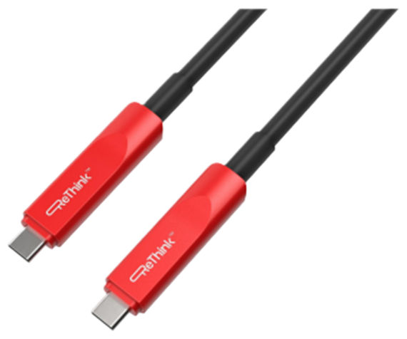
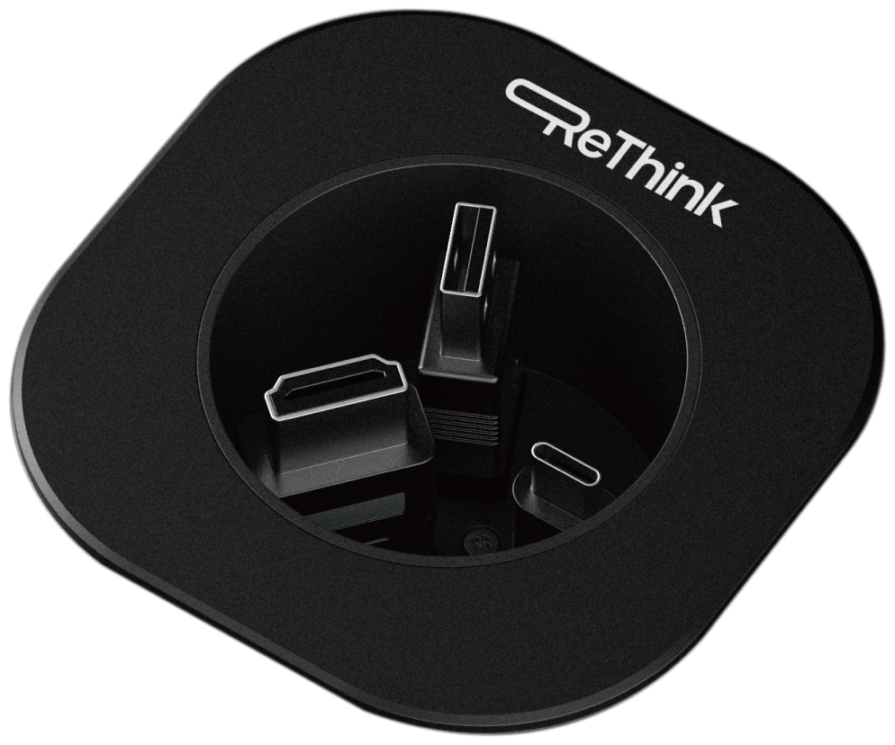
ACCESSORIES
FINISH THE ROOM
The cables and connectivity that complete every BYOM install.
RAV-CA-UC-AOC/FF
RAV-RC-HU
ACTIVE OPTICAL CABLE
IN-DESK CUBBY
USB-C to USB-C active optical cable, full-featured — audio, video, USB, power and data.
Tidy in-desk connectivity cubby keeping every connector to hand at the table.
AVAILABLE LENGTHS: 5m · 8m · 10m · 15m
CONNECTORS: USB-C · HDMI · USB-A

Slide 23
WHERE WE FIT
EVERY ROOM. EVERY SCALE.
From huddle spaces to boardrooms — one cable, every laptop, no IT call.
01
02
03
04
Huddle rooms
Meeting rooms
Boardrooms
Training spaces
2–6 seats. UC SmartHub + USB-C switcher. Walk in, plug in, present.
6–12 seats. Kratos switcher with HDBaseT extension to the display wall.
Dual-display setups. Magni matrix + Osiris extenders — 100m signal reach.
Multi-source switching, presenter laptop, instructor PC, BYOD support.

Slide 24
PARTNERSHIP
NOW DISTRIBUTED BY ASCENTAE.
Signed October 2025. Ascentae’s BYOM portfolio now carries the full ReThink range — Kratos, Magni, Osiris and UC SmartHub — backed by their UK sales, support and logistics infrastructure.
“
Adding ReThink to our portfolio is a natural step in Ascentae’s mission to deliver smarter connectivity to the workplace. Their innovative range of switchers, matrices and extenders directly supports our BYOM strategy.
JON KNIGHT / MANAGING DIRECTOR, ASCENTAE

Slide 25
WHY BUYERS CHOOSE RETHINK
PROOF, NOT PROMISES.
50+
100m
USB-C
UK
YEARS OF AV INTEGRATION EXPERIENCE BEHIND EVERY PRODUCT
FLAGSHIP EXTENSION RANGE — LONGEST IN OUR PORTFOLIO
FIRST AV BRAND ALIGNED WITH THE EU-MANDATED STANDARD
DESIGNED IN BRITAIN — PANTONE 186C, UNION FLAG RED

Slide 26

GET IN TOUCH
READY WHEN YOU ARE
WEB
LET’S RETHINK
YOUR ROOMS.
rethinkav.com
PHONE
+44 7983 135 989
EMAIL
support@rethinkav.com
One cable. One experience. Zero excuses.
UK HEAD OFFICE
Epsom Square, Epsom,
Surrey, KT19 8AG

